Slide 1
Advanced Models and Model Training
By: Satyen S.

Slide 2
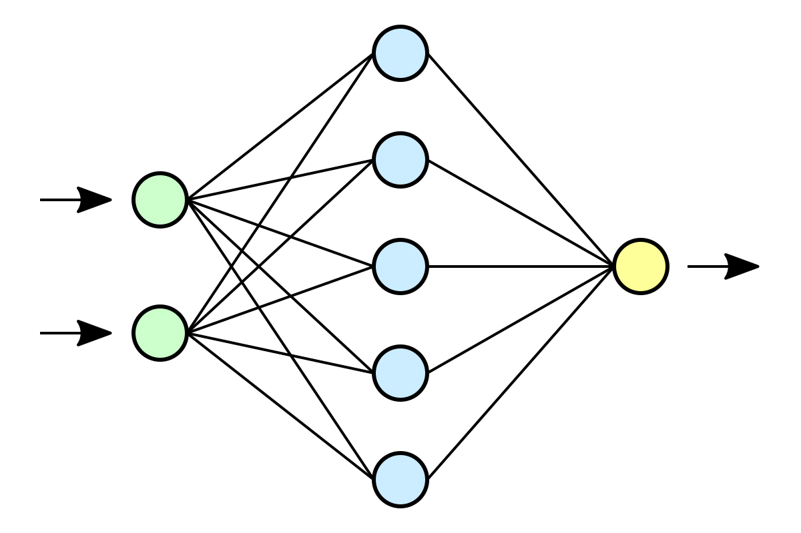
Recap: CNNs
Which of the following is NOT true of a Convolutional Neural Network?
Comprised of different types of network layers
Efficient at detecting a feature anywhere in an image
Susceptible to error when input is translated
Sparse connections between layers

Slide 3
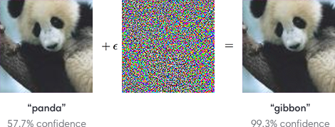
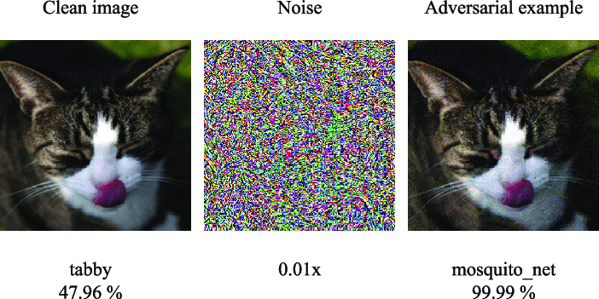
Adversarial Examples
Adversarial examples: input that has small perturbations that are detected by model, but not by humans
Ex: By adding algorithmically calculated noise to input
To combat adversarial examples…
Regularization
Adversarial training
https://analyticsindiamag.com/how-to-deter-adversarial-attacks-in-computer-vision-models/

Slide 4
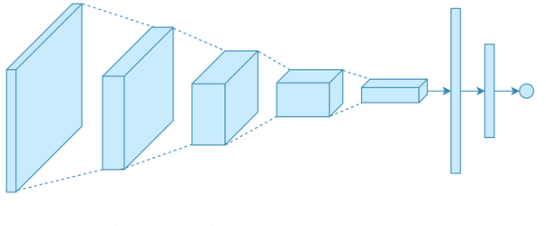
Recap: CNNS
Which of the following correctly orders Convolutional Neural Network layers?
Convolution, Pooling, ReLU
ReLU, Convolution, Pooling
Pooling, Convolution, ReLU
Convolution, ReLU, Pooling

Slide 5
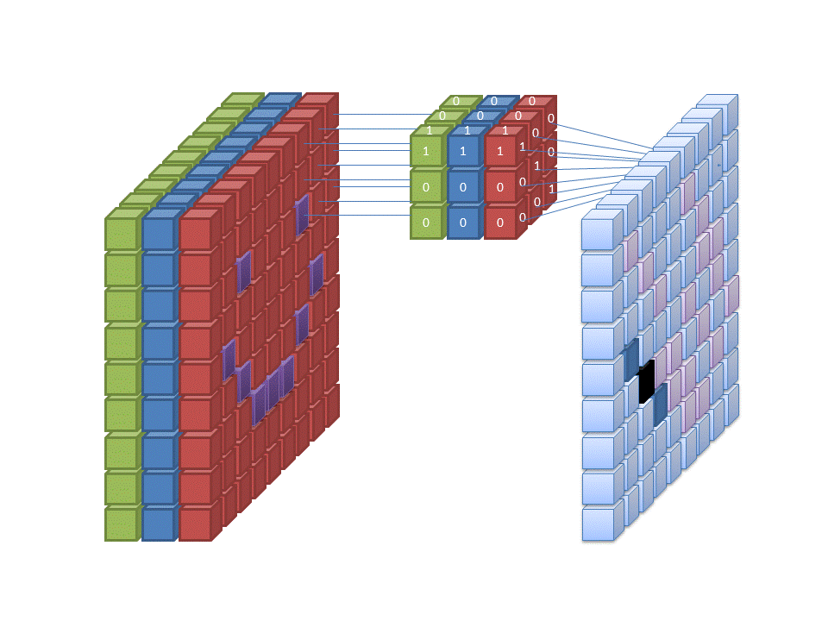
Recap: CNNs
Which of the following combination of a filter size and stride size will lead to the largest output size for a given input?
Small stride, small filter
Large stride, large filter
Small stride, large filter
Large stride, small filter

Slide 6
Optimizing Neural Networks
Generally encouraged optimization procedure
Choose model structure
Optimize learning rate (or use dynamic rate)
Choose optimizer and loss function
Choose batch size and epochs
General advice for tuning hyperparameters: https://machinelearningmastery.com/recommendations-for-deep-learning-neural-network-practitioners/
Using GridSearch with TensorFlow: https://www.analyticsvidhya.com/blog/2021/05/tuning-the-hyperparameters-and-layers-of-neural-network-deep-learning/

Slide 7
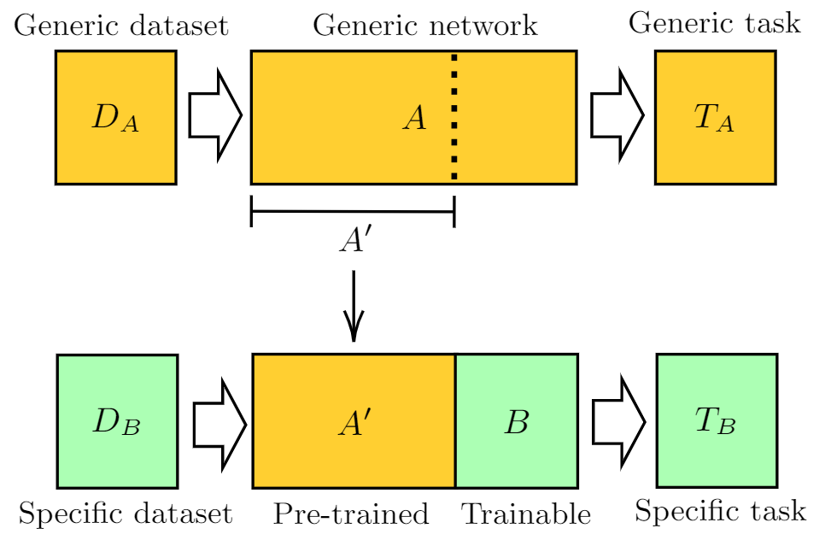
Transfer Learning
We can start from pretrained model and…
Add additional layers and train new layers
Freeze some of the layers and further train some layers with our training dataset
Common models: ResNet, AlexNet, etc.
Generally look for a model used in a similar use case
Further Reading: https://machinelearningmastery.com/transfer-learning-for-deep-learning/

Slide 8

Recurrent Neural Networks: Intuition
So far each set of input data has been independent from next
Different images
Different economic data
We can also have sequential data
Time series data
Series of images (frames from a video)
Audio input
Traditional NN: Input -> Hidden -> Output
RNN: Input + Hidden -> Hidden -> Output

Slide 9
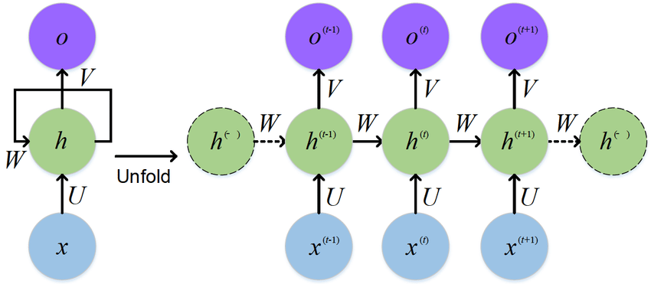
Recurrent Neural Networks: Overview
First set of Inputs provided to model
Hidden layers feed forward (as in traditional NN)
Each hidden layer node ALSO receives a default additional input
Output for first input returned
Second set of inputs provided to model
Model uses previous hidden layer outputs and current inputs to produce second output prediction

Slide 10
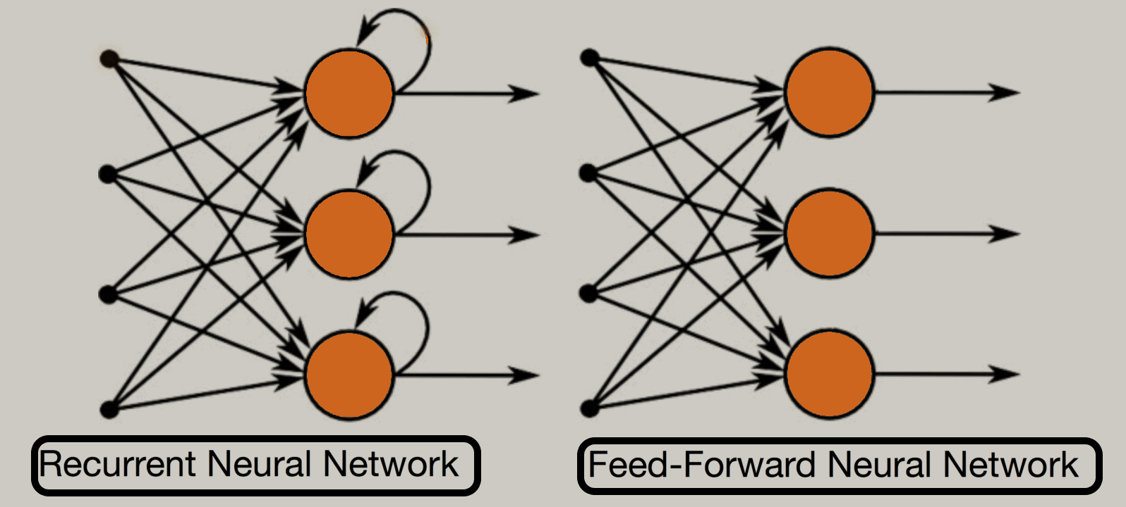
Recurrent Neural Networks: Use Cases
Advantages
Accounts for relationship between historical and current data
Disadvantages
Can be slow and computationally intensive
Cannot run multiple dependent requests in parallel
Vanishing Gradient issue: depends on optimizer used
Does not retain historical data for long time
Speech Recognition, Language Translation, Video Classification, NLP

Slide 11
Recurrent Neural Networks: TensorFlow
Can create RNN layers with TensorFlow Keras
Good Tensorflow RNN walkthrough: https://www.tensorflow.org/text/tutorials/text_generation
Additional reading for RNNs with Keras: https://www.tensorflow.org/guide/keras/rnn

Slide 12

RNNs: Long Short-Term Memory (LSTM)
Q: How can we create model that is dependent on more historical data?
A: LSTM - Long Short-Term Memory
LSTM Cell (green block) is comprised of multiple nodes/layers, but can be treated as a single layer
Four features
Forget
Store
Update
Output
Note: In image, horizontal
arrows represent represent between iterations, vertical arrows pass between layers/cells

Slide 13
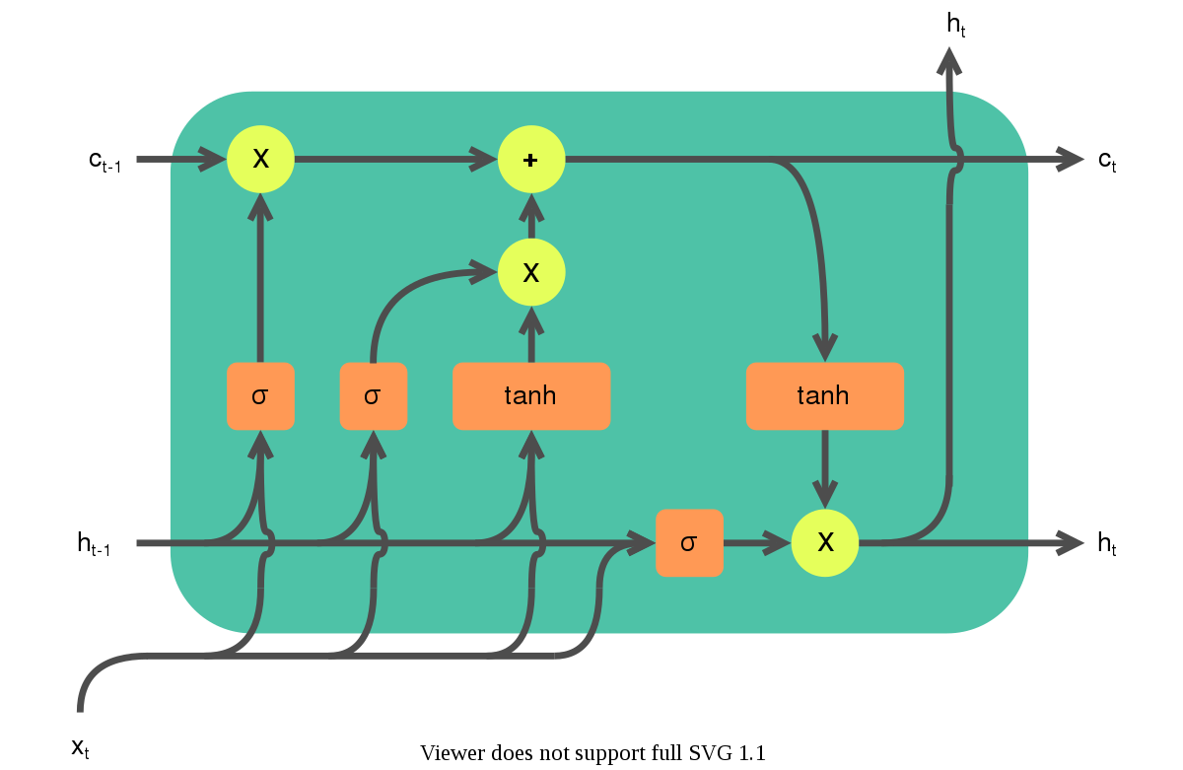
LSTM: Long Term and Short Term Storage
Storage for long term memory with continuous horizontal line (Red)
Storage for short term memory between iterations - like generic RNN (Blue)

Slide 14
LSTM: Forgetting Information
Based off of short term memory and input, calculate what memory to forget (Red)
Long term memory is modified to forget some content (Blue)

Slide 15
LSTM: Updating Storage
Short Term memory and input is processed (Red)
Processed cell input is used to modify long term memory (Blue)

Slide 16
LSTM: Output
Long term memory and input is processed (Red)
Processed data is output and is stored for next iteration in short term memory (Blue)

Slide 17
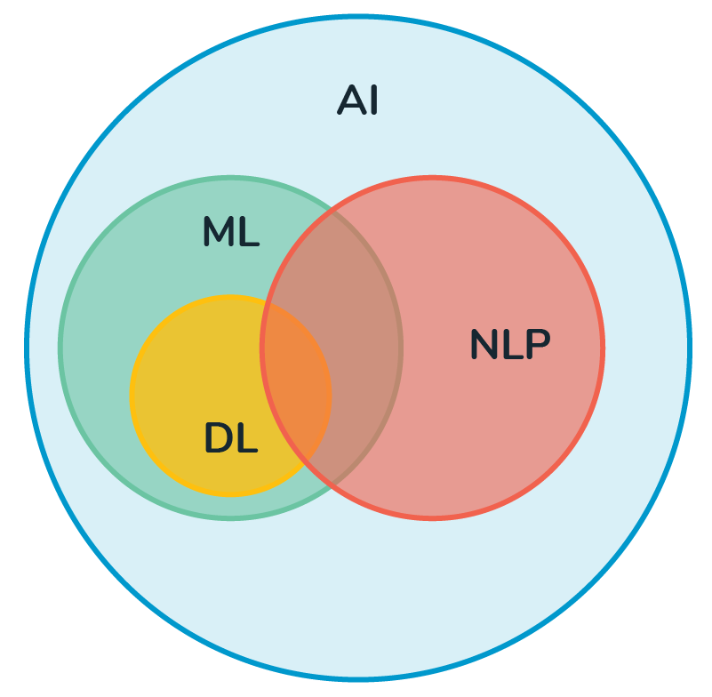
LSTM: Use Cases
LSTMs are fairly complex, so I’d encourage taking a look here: https://machinelearningmastery.com/gentle-introduction-long-short-term-memory-networks-experts/
Reinforcement learning
Time series predictions
NLP
Video/Audio processing

Slide 18

Bigquery Native Models
Can train models within bigquery with SQL syntax (to create, query, move, etc.)
Allows you to train TensorFlow models externally and import them (cannot view metrics, but can move, query, etc.)
Documentation: https://cloud.google.com/bigquery-ml/docs/introduction

Slide 19


Conclusion
Intuition and technical skills for machine learning
Basics for model optimization techniques and hyperparameters
Understanding of deep learning models and structure
Resources to refresh fundamentals and build upon them

